Slide 1
Weak Slot-and-Filler Structures
Chapter 9

Slide 2
Weak Slot-and-Filler Structures
Index assertions by the entities they describe.
Make it easy to describe properties of relations.
Are a form of object-oriented programming.
Support both monotonic and Nonmonotonic inference.
208

Slide 3
Semantic Networks
The idea behind a semantic network is that knowledge is often best understood as a set of concepts that are related to one another.
The meaning of a concept is defined by its relationship to other concepts.
A semantic network consists of a set of nodes that are connected by labeled arcs. The nodes represent concepts and the arcs represent relations between concepts.

Slide 4
Common Semantic Relations
INSTANCE: X is an INSTANCE of Y if X is a specific example of the general concept Y.
Example: Elvis is an INSTANCE of Human
ISA: X ISA Y if X is a subset of the more general concept Y.
Example: sparrow ISA bird
HASPART: X HASPART Y if the concept Y is a part of the concept X. (Or this can be any other property)
Example: sparrow HASPART tail

Slide 5
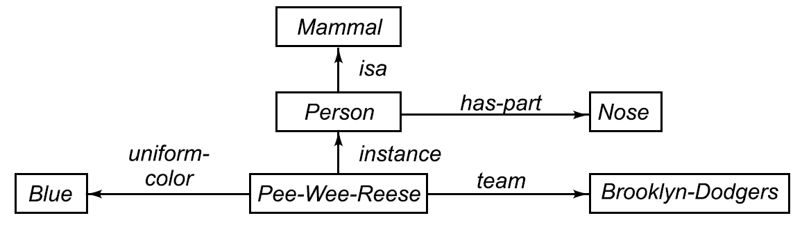
A Semantic Network
209

Slide 6
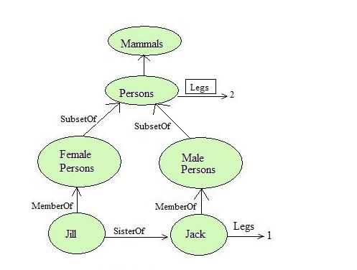

Slide 7


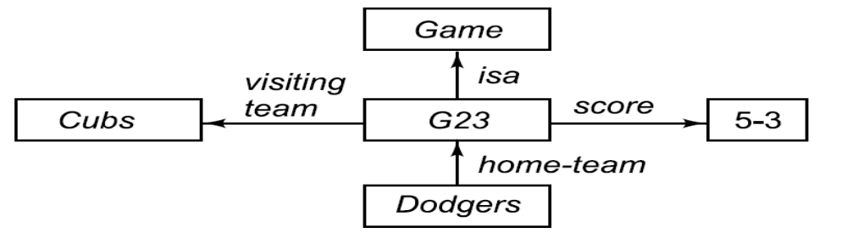
Representing Nonbinary Predicates
Unary Predicates can be rewritten as binary ones.
could be rewritten as
N-Place Predicates
becomes
210

Slide 8
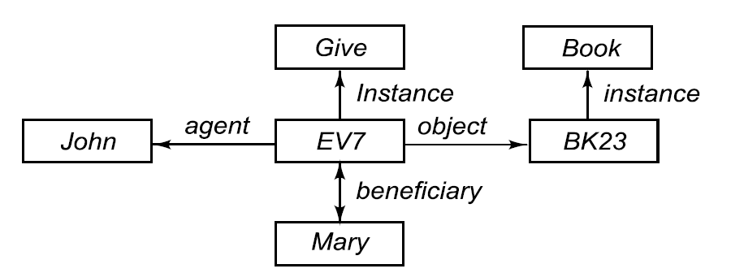
A Semantic Net Representing a Sentence
“John gave the book to Mary.”
211

Slide 9

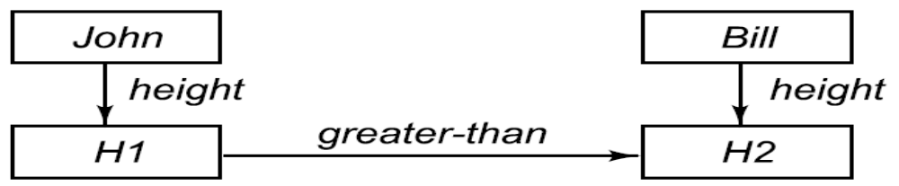
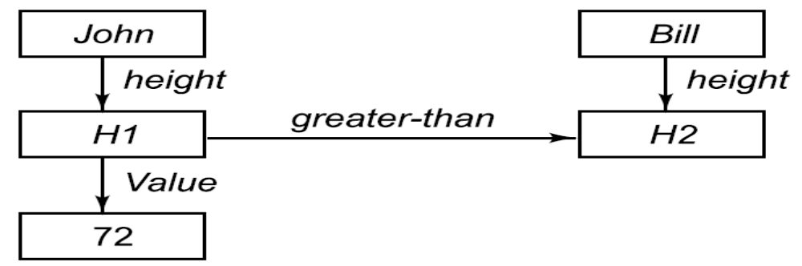
Some Important Distinctions
First try :
Second try :
Third try :
212

Slide 10
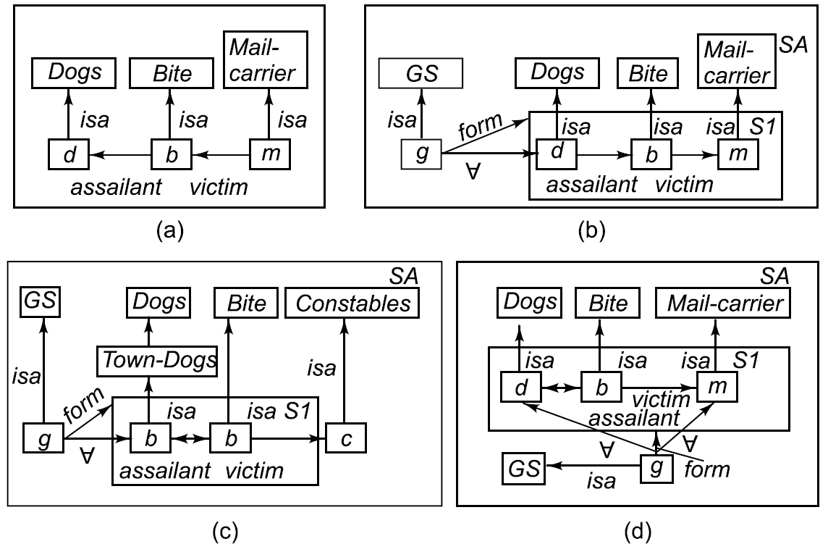
Partitioned Semantic Nets
The dog bit the mail carrier.
Every dog has bitten a mail carrier.
Every dog in town has bitten the constable.
Every dog has bitten every mail carrier.
213

Slide 11
Advantage
Semantic nets have the ability to represent default values for categories.
Semantic nets convey some meaning in a transparent manner.
Semantic nets are simple and easy to understand.
Semantic nets are easy to translate into PROLOG.

Slide 12
Disadvantages
Links between the objects represent only binary relations. For example, the sentence Run(ChennaiExpress, Chennai,Bangalore,Today) cannot be asserted directly.
Some types of properties are not easily expressed using a semantic network. For example: negation, disjunction, and general non-taxonomic knowledge.
There is no standard definition of link names.

Slide 13
Frames
A frame represents an entity as a set of slots (attributes) and associated values.
Each slot may have constraints that describe legal values that the slot can take.
A frame can represent a specific entity, or a general concept.
Frames are implicitly associated with one another because the value of a slot can be another frame.

Slide 14
what is a frame?
A frame is a data structure with typical knowledge about a particular object or concept.
Frames were first proposed by Marvin Minsky in the 1970s.
Each frame has its own name and a set of attributes associated with it. Name, weight, height and age are slots in the frame Person.
Model, processor, memory and price are slots in the frame Computer. Each attribute or slot has a value attached to it.

Slide 15
what is a frame?
Frames provide a natural way for the structured and concise representation of knowledge
A frame provides a means of organising knowledge in slots to describe various attributes and characteristics of the object.
Frames are an application of object-oriented programming for expert systems.

Slide 16
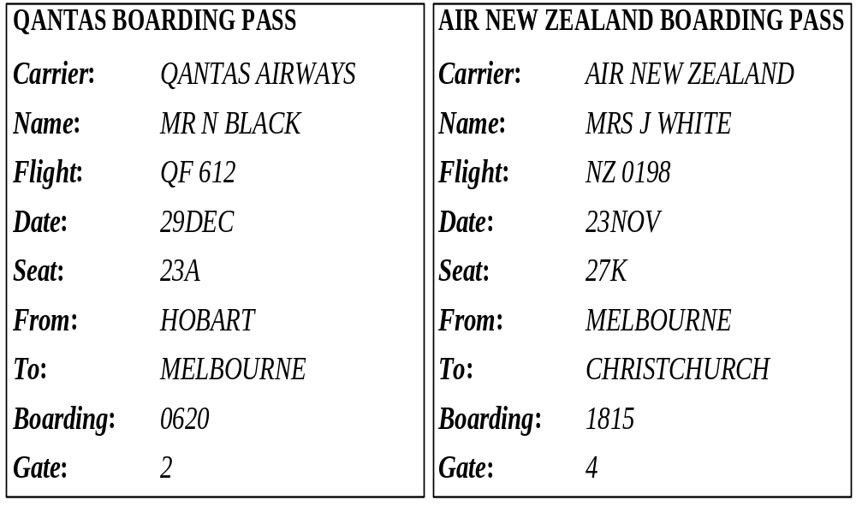
Boarding pass frames

Slide 17
Object-oriented programming is a programming method that uses objects as a basis for analysis, design and implementation.
An object combines both data structure and its behaviour in a single entity.
A knowledge engineer refers to an object as a frame (the term, which has become the AI jargon).

Slide 18
Frames as a knowledge representation technique
The concept of a frame is defined by a collection of slots. Each slot describes a particular attribute or operation of the frame.
Slots are used to store values. A slot may contain a default value or a pointer to another frame, a set of rules or procedure by which the slot value is obtained.

Slide 19
Typical information included in a slot
Frame name.
Relationship of the frame to the other frames. The frame IBM Aptiva S35 might be a member of the class Computer, which in turn might belong to the class Hardware.
Slot value. A slot value can be symbolic, numeric or Boolean. For example, the slot Name has symbolic values, and the slot Age numeric values. Slot values can be assigned when the frame is created or during a session with the expert system.

Slide 20
Default slot value. The default value is taken to be true when no evidence to the contrary has been found. For example, a car frame might have four wheels and a chair frame four legs as default values in the corresponding slots.
Range of the slot value. The range of the slot value determines whether a particular object complies with the stereotype requirements defined by the frame. For example, the cost of a computer might be specified between $750 and $1500.
Procedural information. A slot can have a procedure attached to it, which is executed if the slot value is changed or needed.

Slide 21
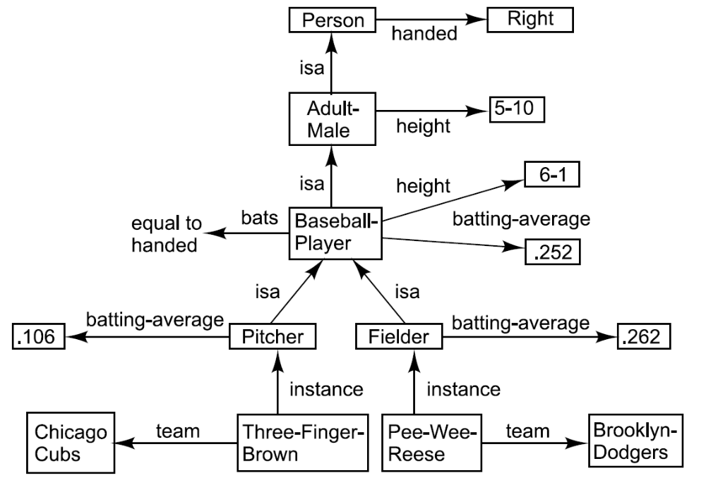
frames

Slide 22
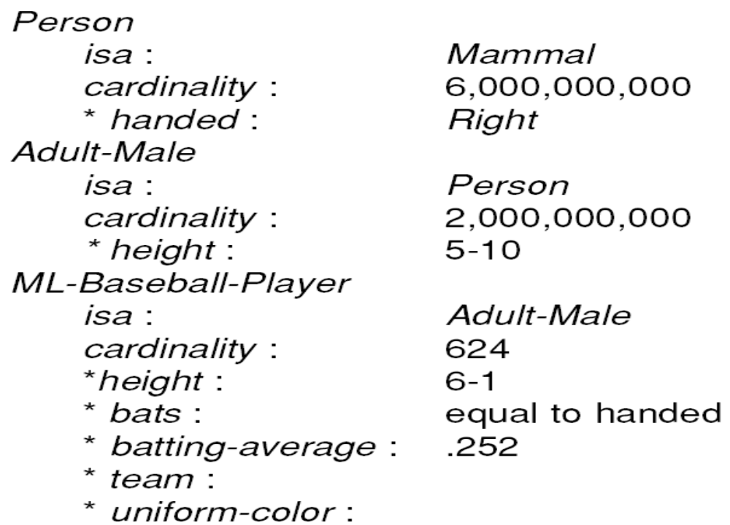
A Simplified Frame System
214

Slide 23
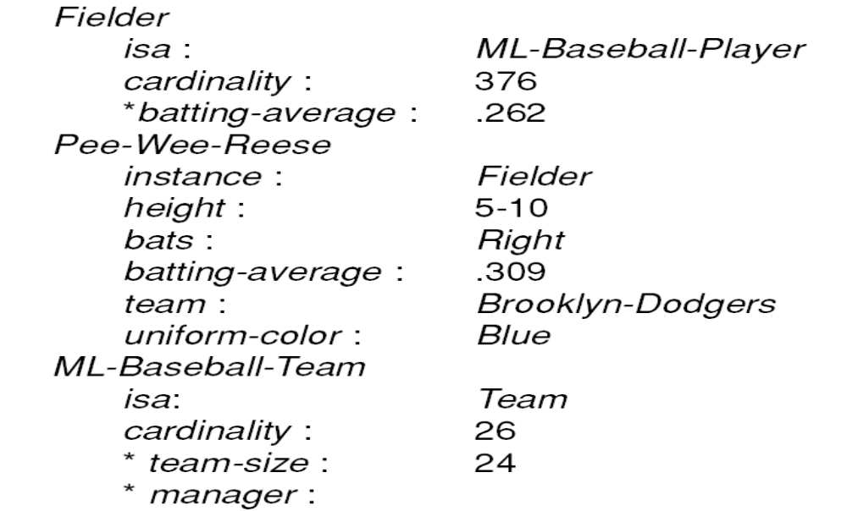
A Simplified Frame System (Cont’d)
215

Slide 24
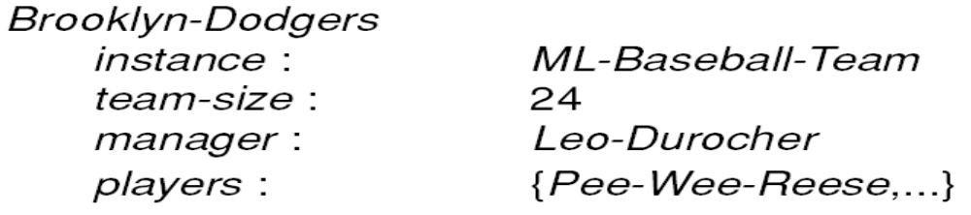
A Simplified Frame System (Cont’d)
216

Slide 25
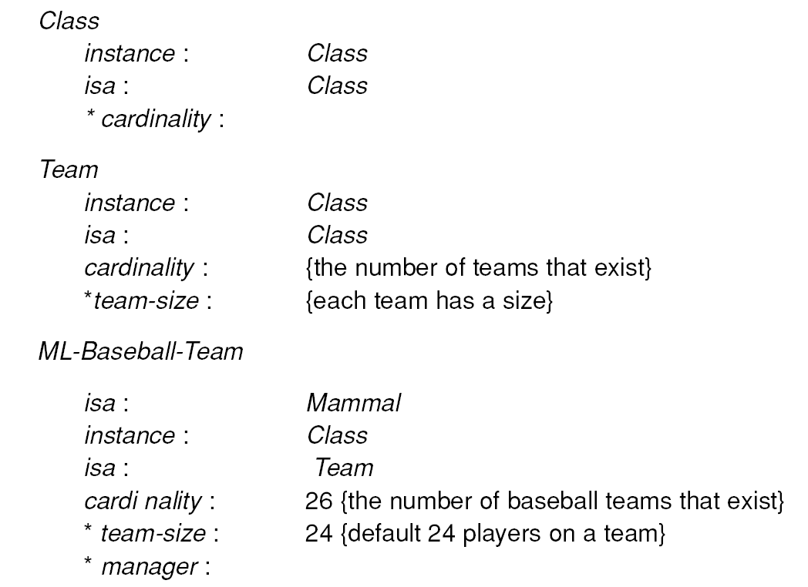
Representing the Class of All
Teams as a Metaclass
217

Slide 26
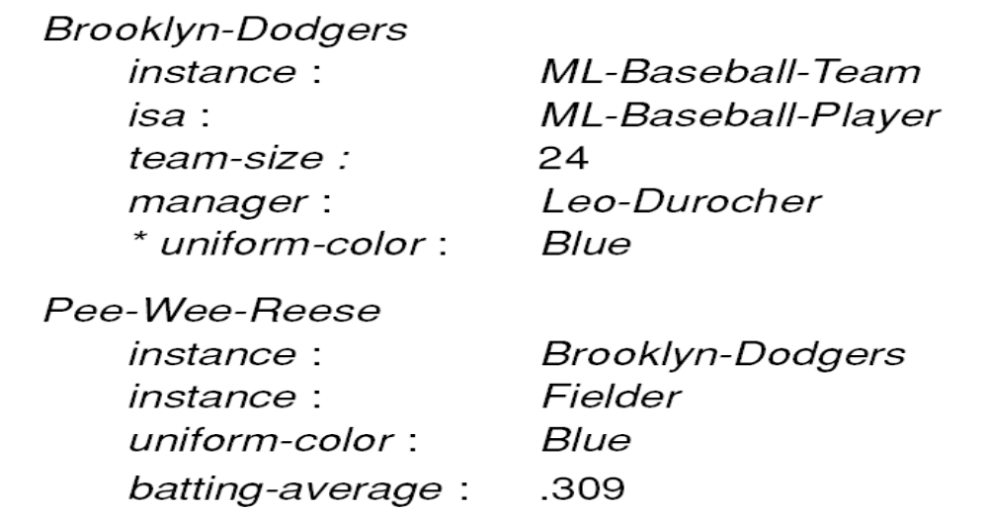
Representing the Class of All
Teams as a Metaclass (Cont’d)
218

Slide 27
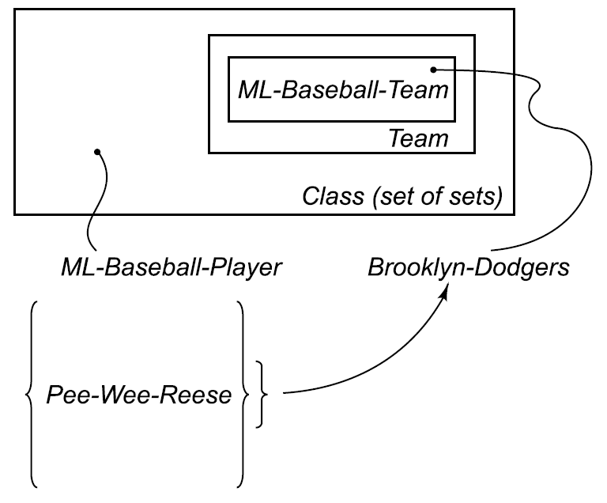
Classes and Metaclasses
219

Slide 28
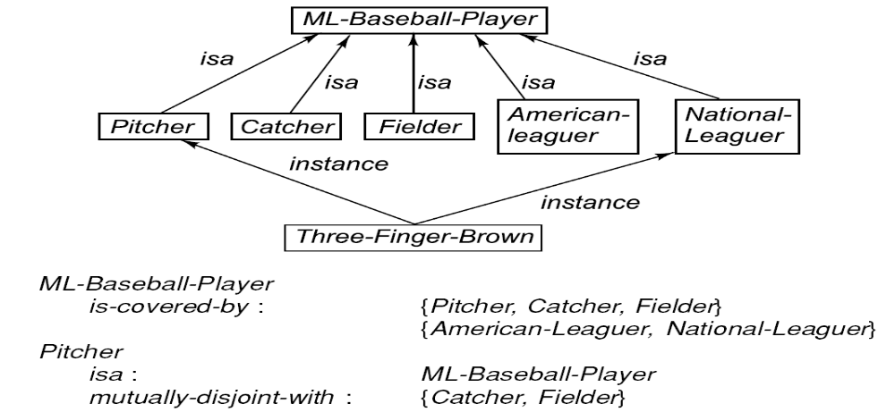
Representing Relationships among Classes
220

Slide 29
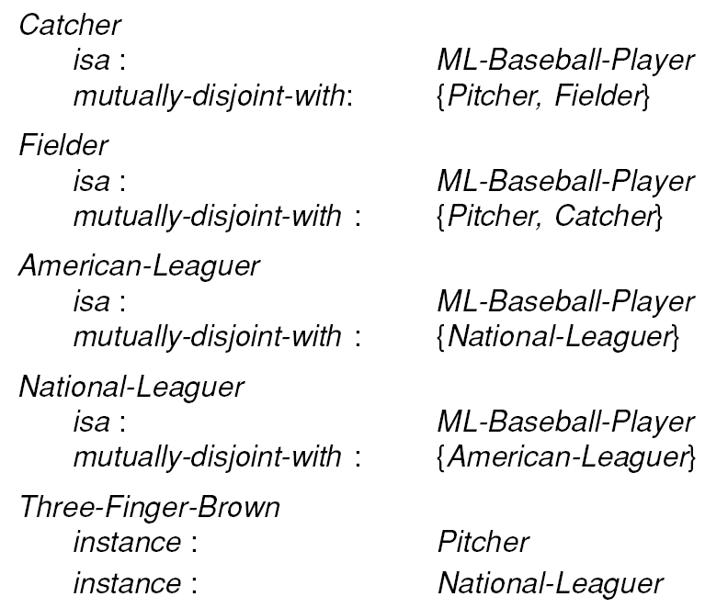
Representing Relationships
among Classes (Cont’d)
221

Slide 30
Slots as Full – Fledged Objects
We want to be able to represent and use the following properties of slots (attributes or relations) :
The classes to which the attribute can be attached.
Constraints to either the type or the value of the attribute.
A value that all instances of a class must have by the definition of the class.
A default value for the attribute.
Rules for inheriting values for the attribute.
Rules for computing a value separately from inheritance.
An inverse attribute.
Whether the slot is single-valued or multivalued.
222

Slide 31
